Slide 1
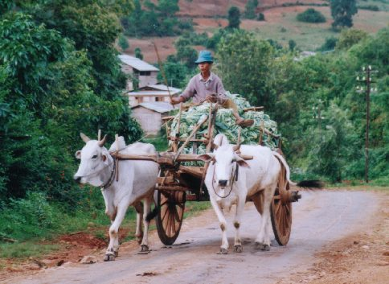
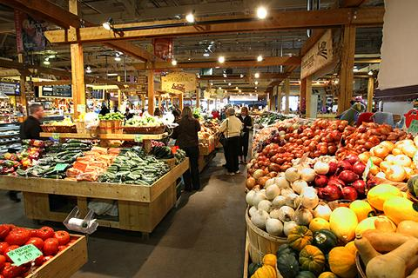
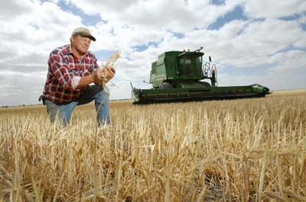
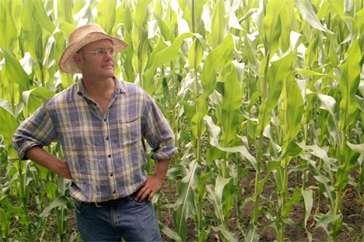

FeBiz (Fair Electronic Business)
Adnan Ashraf {aashraf@abo.fi }
Alonso J. Gragera Aguaza {agragera@abo.fi }
Ali Hanzala Khan {akhan@abo.fi}
Md. Nazmul Haque Khan {nhk985@gmail.com}
Åbo Akademi University

Slide 2

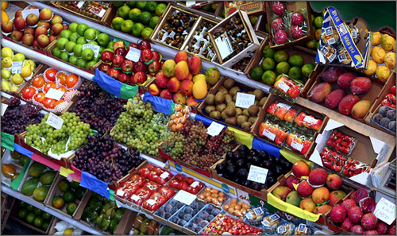
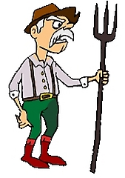

Problem
Middlemen
Farmers earn less profit
Middlemen earn a lot of profit
Companies pay higher prices

Slide 3


Solution
Need 500KG coffee beans
200 KG
FeBiz
(Web-based B2B Platform)
100 KG
200 KG
Farmers earn more profit
FeBiz earns a “fair” amount of profit
Companies pay lower prices

Slide 4
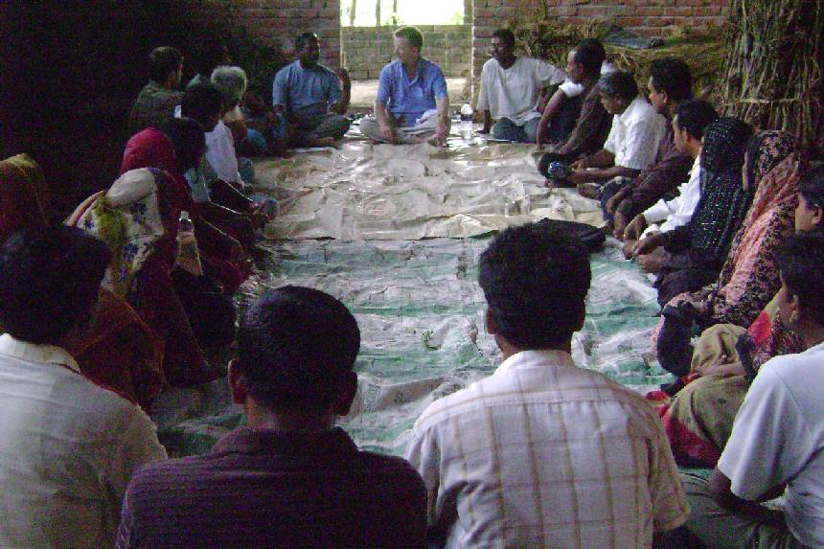
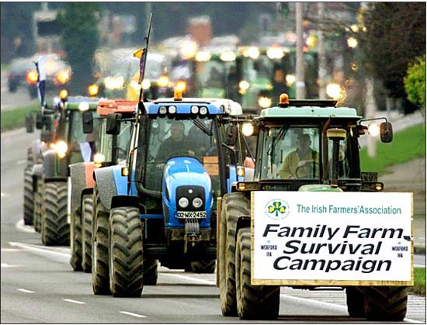
Business Value
Potential Customers
Middlemen
FeBiz minimizes middlemen’s role
They need to find new ways to do business
Why not own FeBiz
Farmer associations
Such as, Finnish Fish Farmers’ Association
FeBiz aims to enable farmers to earn more
So do farmer associations

